Slide 1
11 months ago a 15 year old Swedish girl named Greta Thunberg decided not to go to school that day and instead she sat down outside the Swedish parliament to protest against climate change.

Slide 2
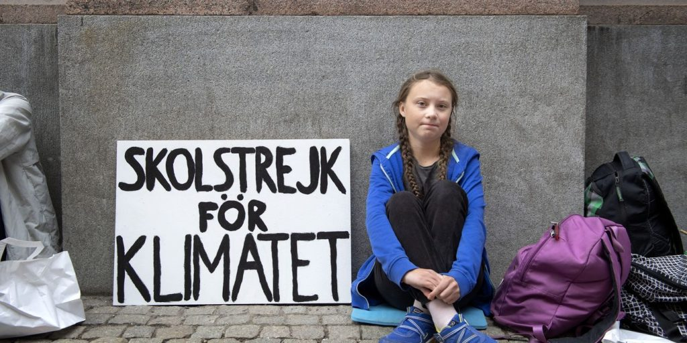

Slide 3
11 months later nearly 2 million people from all over the world have joined Greta in her protest…

Slide 4
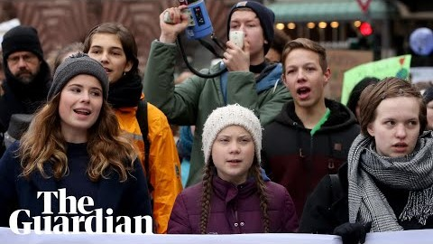

Slide 5
Why?
What are these protests about?

Slide 6


Slide 7
Our planet is getting hotter and we need to make changes to save our home.
Animals are dying because of our actions and we need to help them, NOW.
Scientists agree that we must act now to slow the worst effects of climate change.

Slide 8
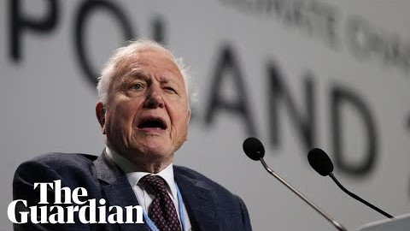

Slide 9
Some Governments, Councils and Universities have decided to make an announcement about the seriousness of the situation we are in.
This is called declaring a Climate Emergency and Scotland was the first country in the World to do this:
https://www.independent.co.uk/environment/climate-change-scotland-emergency-global-warming-nicola-sturgeon-snp-conference-a8891071.html

Slide 10
Now we are asking you, everyone here at Marsh Baldon school to think about whether WE should declare a Climate Emergency and start making our own changes to help reduce the effects of Climate Change.
Thank you for listening.

